Slide 1

BATCH - B GROUP 1
SPEECH PROCESSING
Why is My Baby Crying? Explainable Emotion Recognition with Domain-Aware Ensemble Models
Kishor S
Sarvesh K
Vishal A S
Durai Singh K

Slide 2
PROBLEM STATEMENT
  Infants communicate their needs primarily through crying
  But distinguishing the reason—whether it's hunger, discomfort, pain, or illness—can be challenging for parents.
  Misinterpretation of a baby's cry can lead to delayed responses, increased parental stress, and potential health risks for the baby.
STUDY
  A study found that 5.6% of parents of 6-month-old infants reported resorting to actions like smothering, slapping, or shaking their baby due to crying.[1]
  Up to 27% of parents describe problems with infant crying in the first four months.[2]
  Excessive crying affects around 20% of infants in the first months of life and is linked to parental anxiety and depression.[3]

Slide 3
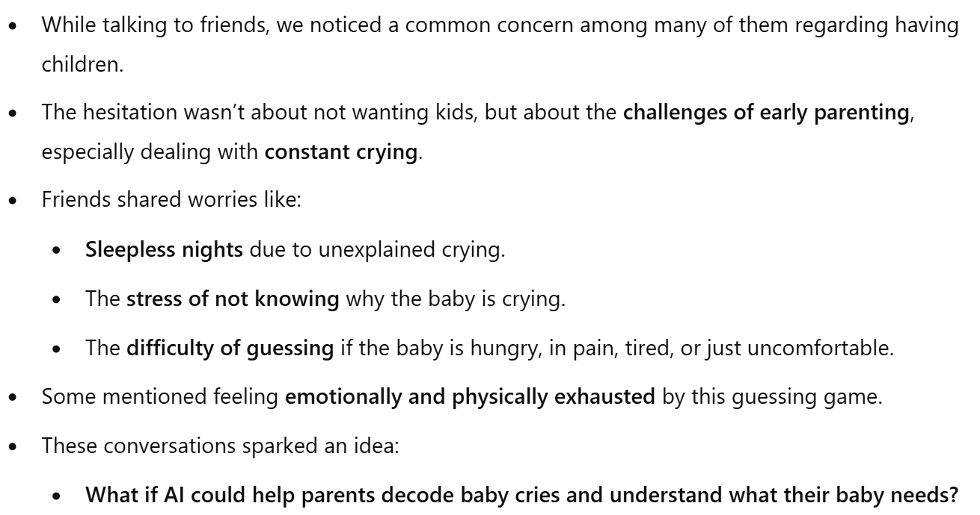
MOTIVATION

Slide 4



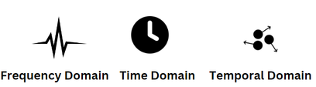


OBJECTIVE
  Classify Baby Cries – Develop an AI-based system to classify the reasons behind a baby’s cry.
  Send Real-time Alerts – Notify parents via mobile messages with the detected reason and suggested actions.
  Interpretability & Explainability – Build a model that provides insights into why a specific decision was made, contributing to future research.
  Feature Importance Analysis – Identify which Feature contribute the most to of baby cry emotion.
  Efficiency & Performance Optimization – Develop a model that is computationally efficient while maintaining high accuracy.
  Alternative to Deep Learning Models – Most high-accuracy models on the Donate-a-Cry dataset rely on deep learning. We aim to develop an efficient and interpretable alternative.
X

Slide 5
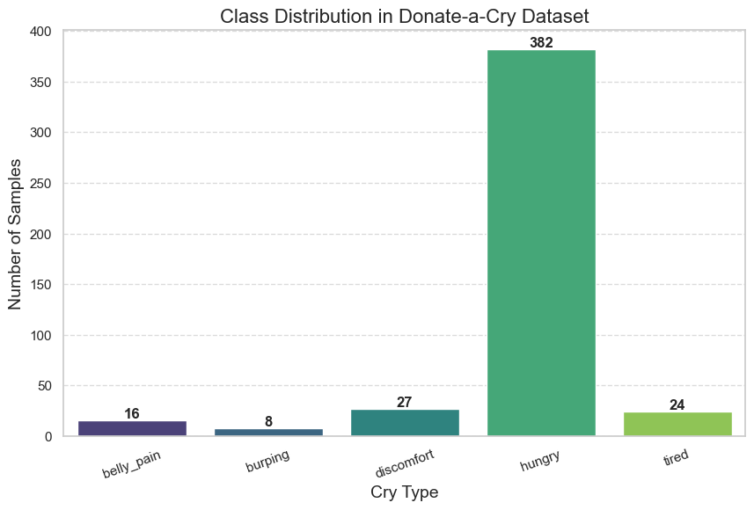
The Donate-a-Cry dataset consists of 457 recordings categorized into five emotion classes: belly pain, burping, discomfort, hunger, and tiredness.
Split = 80/20
✅ Train Set → 366 samples
✅ Test Set → 91 samples
DATASET

Slide 6
LITERATURE SURVEY
Paper Name | Key Takeaway | Research Gap
TabNet: Attentive Interpretable Tabular Learning | TabNet uses attention mechanisms for feature selection, balancing interpretability and performance while outperforming tree-based models on structured data. | -
Unveiling Hidden Factors: Explainable AI for Feature Boosting in Speech Emotion Recognition | Uses SHAP and LIME to interpret feature importance in emotion classification models | Not applied to Baby Cry
Infant Mood Prediction and Emotion Classification with Different Intelligent Models | Importance of MFCC features , Preprocessing (noise reduction) and use of Random forest to achive an accuracy of 91% | Does not taken into considersation of Class imblance
Classification of Infant Cry Based on Hybrid Audio Features and ResLSTM | Hybrid feature extraction of MFCC, Tonnetz AND MEL | Uses heavy weight deep learning models and no XAI

Slide 7
LITERATURE SURVEY
Paper Name | Key Takeaway | Research Gap
Infant cry classification using an efficient graph structure and attention-based mode | Proved that Attention based model can improve accuracy | Uses attention with CNN and LSTM, making the model less interpretable and heavily reliant on MFCC instead of better feature extraction.
Data Augmentation and Deep Learning Methods in Sound Classification: A Systematic Review" | Data augmentation techniques, such as noise variation, signal intensity variation, tonality variation, and spectrogram’s size alteration, were used to artificially increase the number of audio signals
Dunstan_Baby_Language | “Neh” = hungry, “Eh” = need to burp, “Oah” = tired, “Eairh” = low belly pain, and “Heh” = physical discomfort. | They havent employed any method to use this for classification

Slide 8
NOVELTY
Single Corpus Utilization:
  Leverages only the DonateACry corpus, ensuring consistency in data quality and real-world relevance.
Efficient and Interpretable Model:
  Uses a classical Random Forest model, achieving 98.76% accuracy with significantly lower computational cost compared to deep learning alternatives.
  Provides clear feature importance, enhancing model transparency and interpretability.
Robust Feature Engineering:
  Extracts 461 handcrafted features capturing diverse acoustic cues (MFCCs, spectral, temporal features) to fully characterize infant cries.
Hybrid Balancing Strategy:
  Combines domain-specific data augmentation (e.g., pitch shifting, time stretching, noise addition) with SMOTE to achieve uniform class distribution.
  This dual approach improves data diversity and minimizes class imbalance, leading to better generalization.
Real-Time Deployment Potential:
  The efficiency and low inference cost make the model ideal for edge-device deployment in real-world caregiving scenarios.

Slide 9
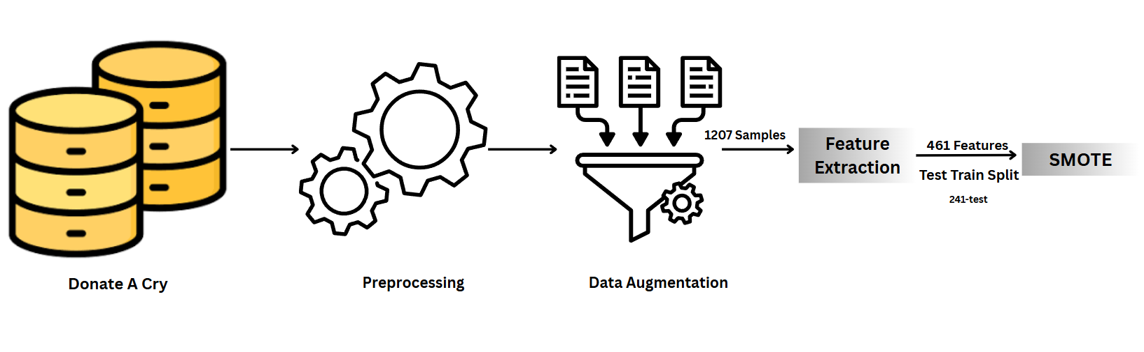
OVERALL ARCHITECTURE

Slide 10
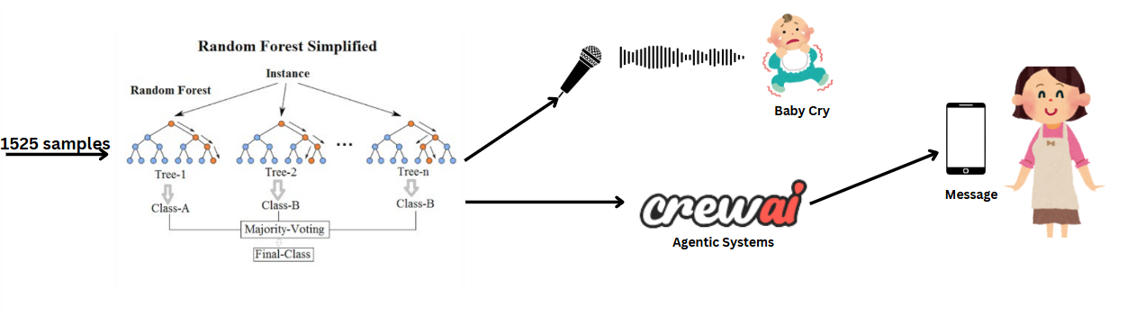
OVERALL ARCHITECTURE

Slide 11
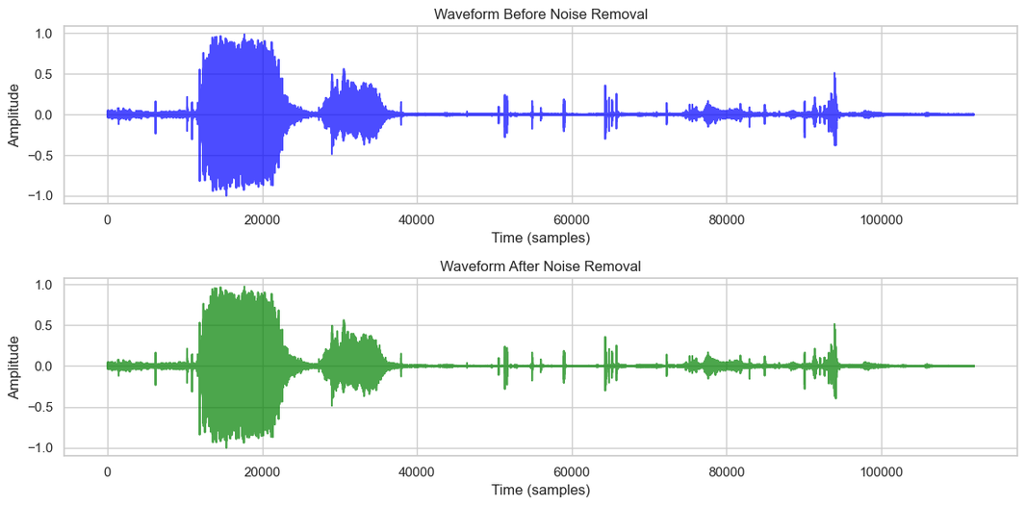
PREPROCESING
  Infant cry sounds are recorded using different mobile devices, leading to variations in quality and noise levels.
  Background noise, such as people talking and environmental sounds, corrupts the signals, making preprocessing essential.
  Fourier Transform (FFT) is applied to convert the audio from the time domain to the frequency domain for better analysis.
  Analysis of 50 random baby cry samples revealed that most infant cries fall between 142.91 Hz – 6620.12 Hz.
  A Bandpass Filter is applied to allow only frequencies within this range, removing unwanted noise.

Slide 12
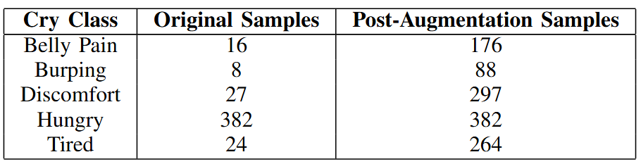
DATA AUGUMENTATION
  Time Stretching: Speeds up or slows down the cry without altering pitch — introduces natural variability in rhythm.
  Pitch Shifting: Alters the tone slightly — mimics cries from different babies or emotional tones.
  Noise Addition: Adds background sounds — makes model more resilient to real-world noise.
  Gain Adjustment: Changes volume — simulates cries of varying intensity.
  Shifting: Moves the audio signal left/right in time — creates positional variance in the cry onset.
Increased training samples from original data to 1,207 samples after augmentation

Slide 13
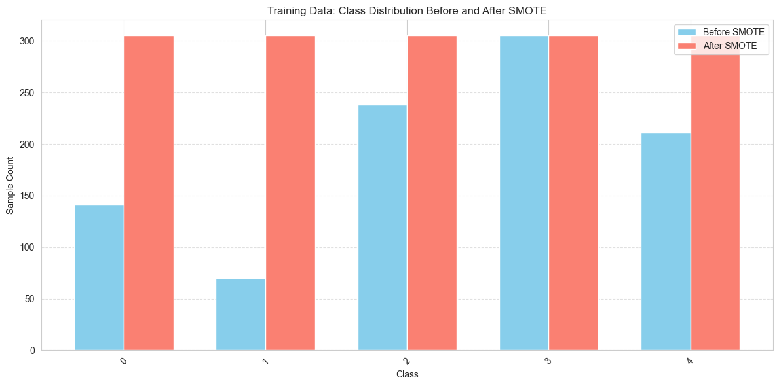
DATA AUGUMENTATION
Used in Combination with SMOTE:
  Augmentation creates new realistic samples, while SMOTE fills remaining gaps synthetically, leading to a well-balanced and expressive dataset
Increased training samples from 966 samples TO 1525 samples

Slide 14
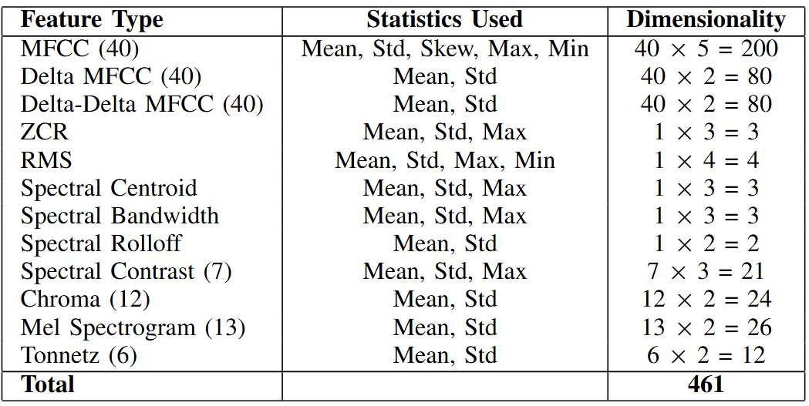
FEATURES EXTRACTED

Slide 15
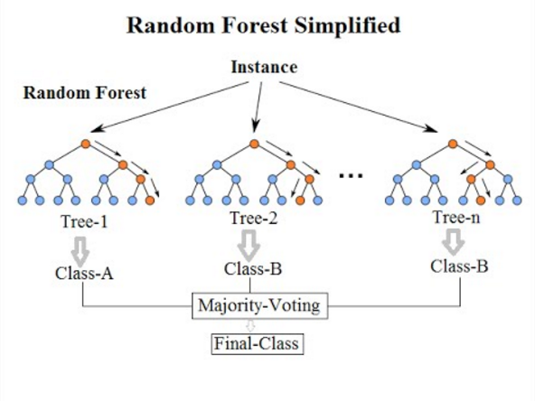
MODEL ARCHITECTURE

Slide 16
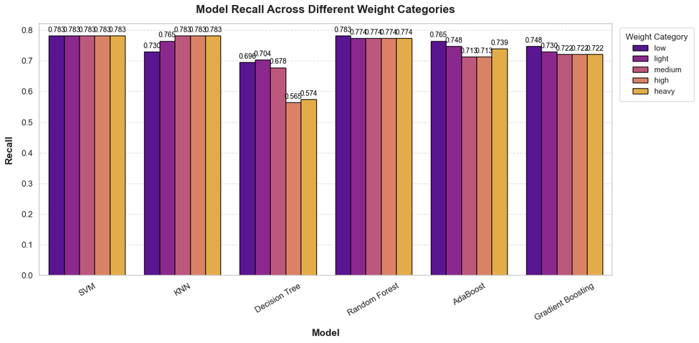
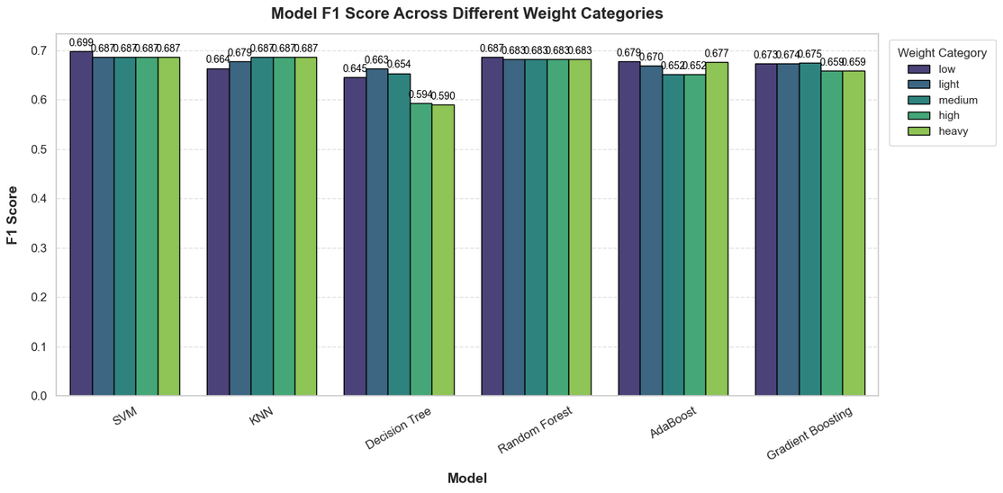
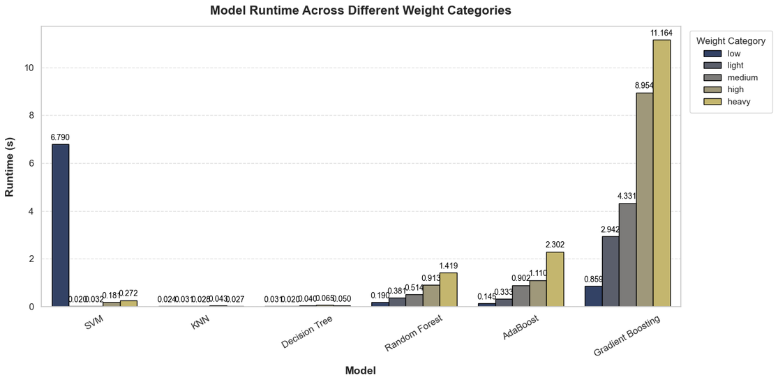
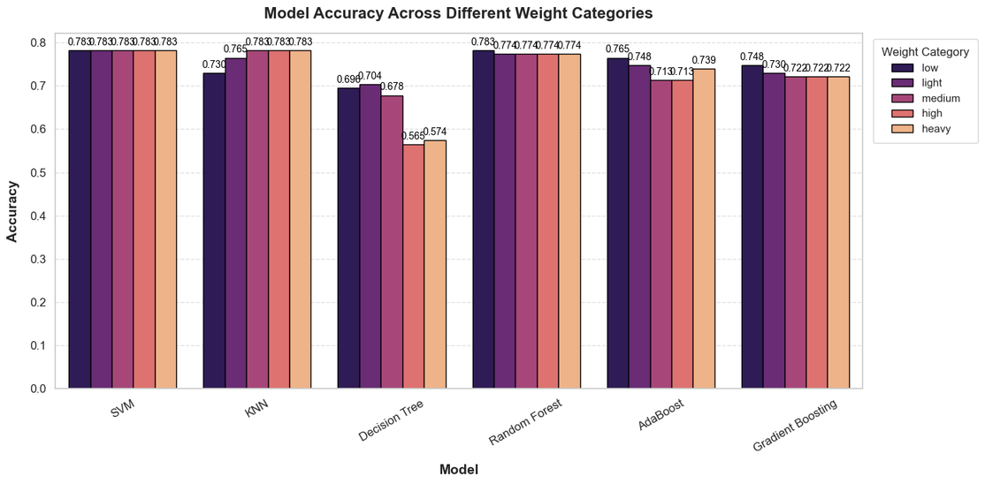
ML MODELS COMPARISON

Slide 17
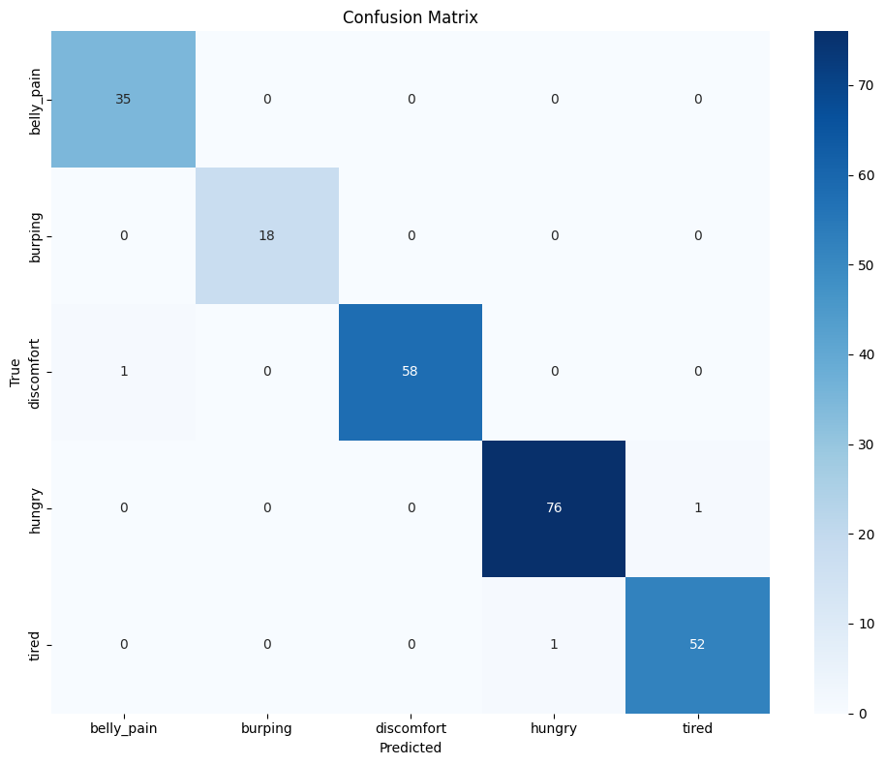

RESULTS
Accuracy:98.76
F1-Score: 98.76
Recall: 98.76

Slide 18
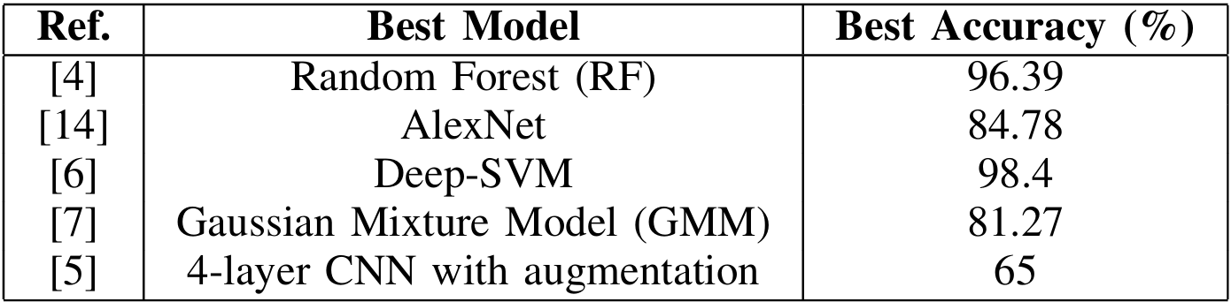
COMPARATIVE ANALYSIS OF BEST MODELS

Slide 19
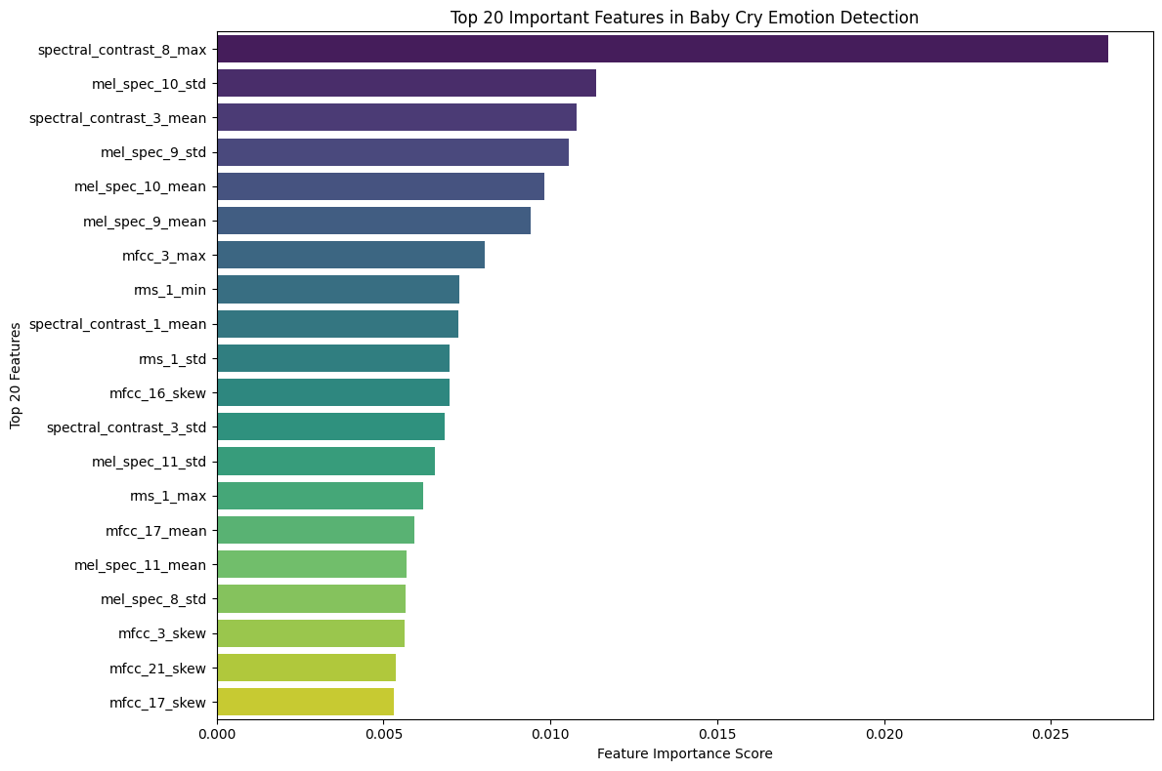
FEATURE IMPORTANCE
As we can see Spectral , MEL and MFCC features contiribute the most

Slide 20
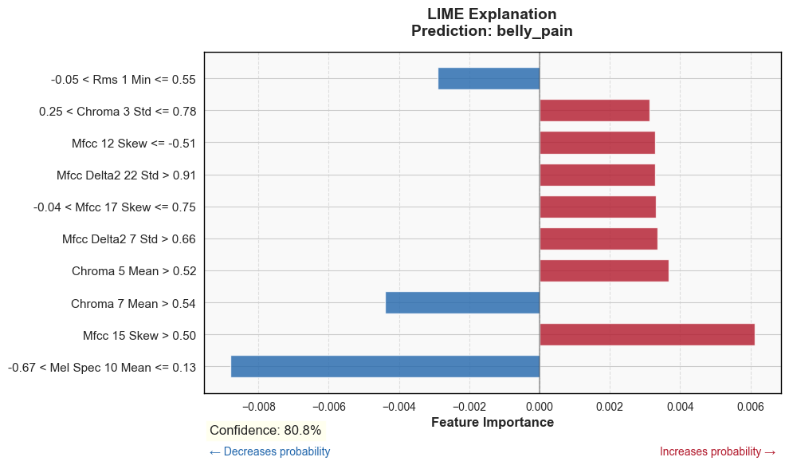
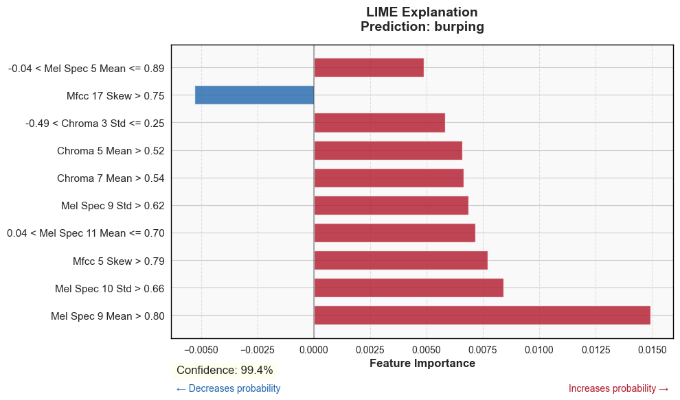
LIME

Slide 21
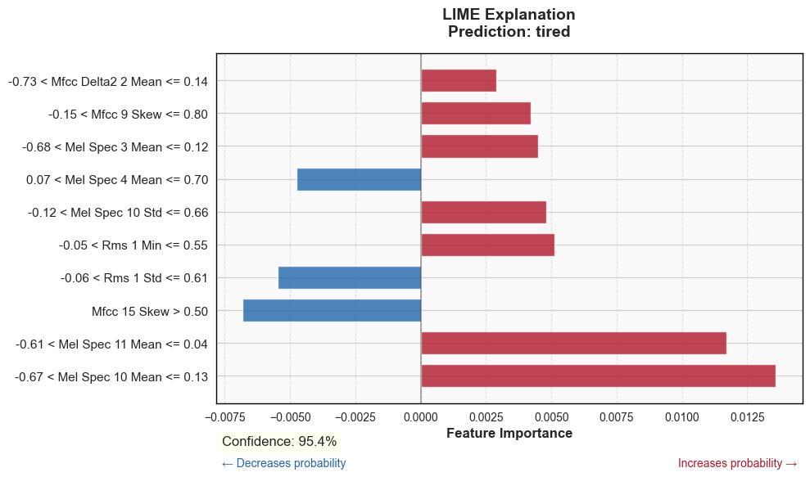
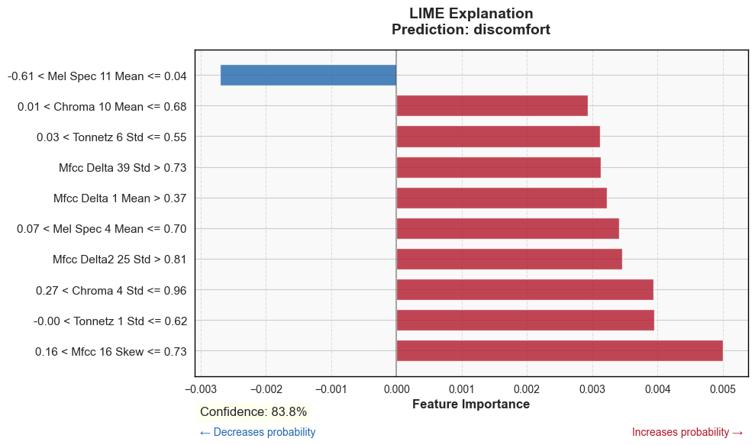
LIME

Slide 22
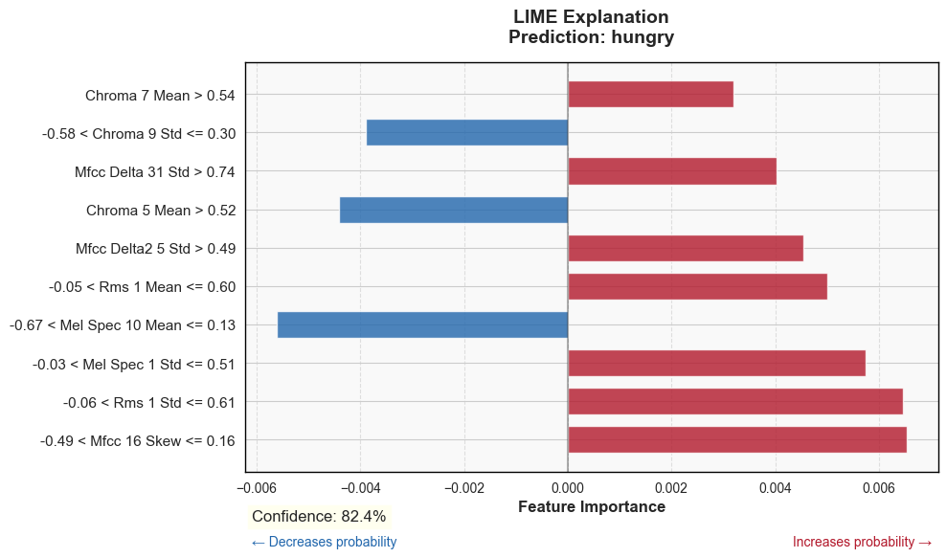
LIME

Slide 23
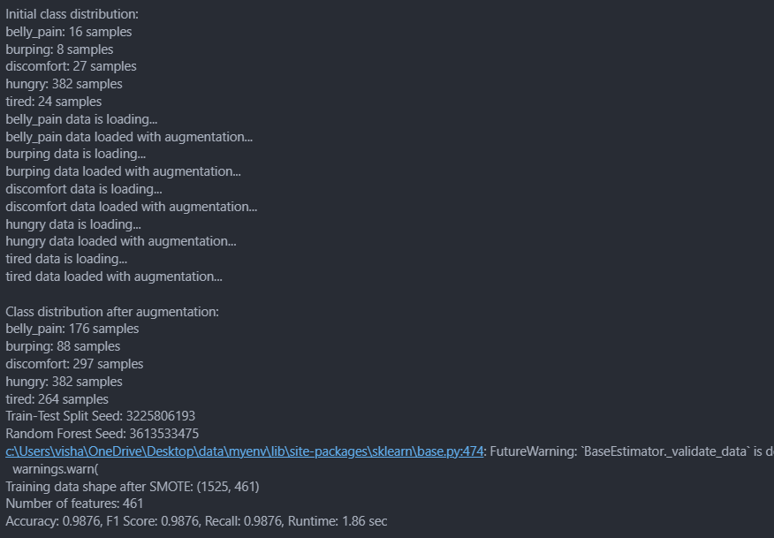
TERMINAL OUTPUTS

Slide 24
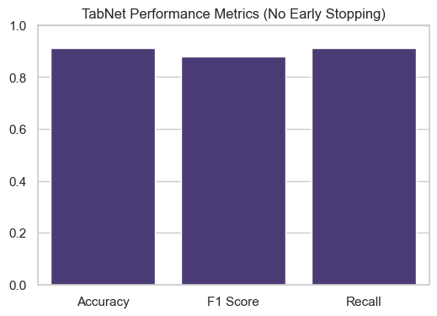
TABNET OUTPUTS

Slide 25
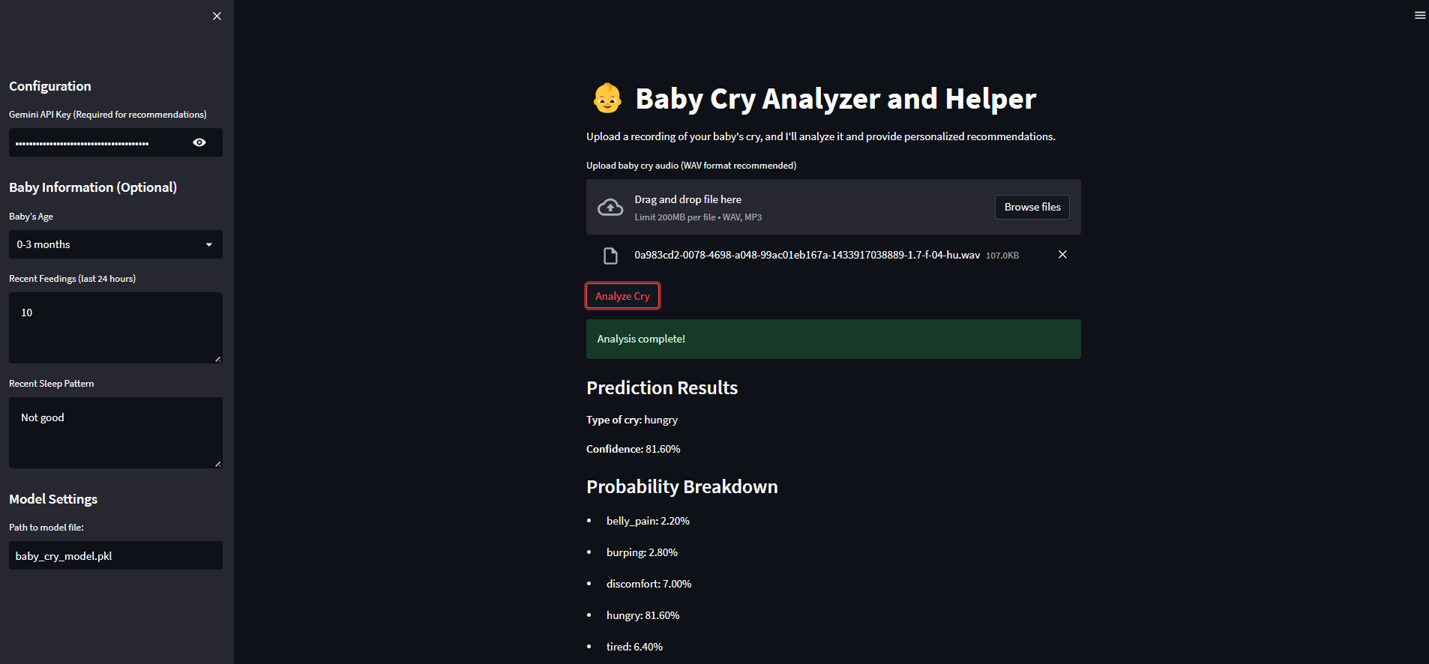
AGENTIC SYSTEM

Slide 26
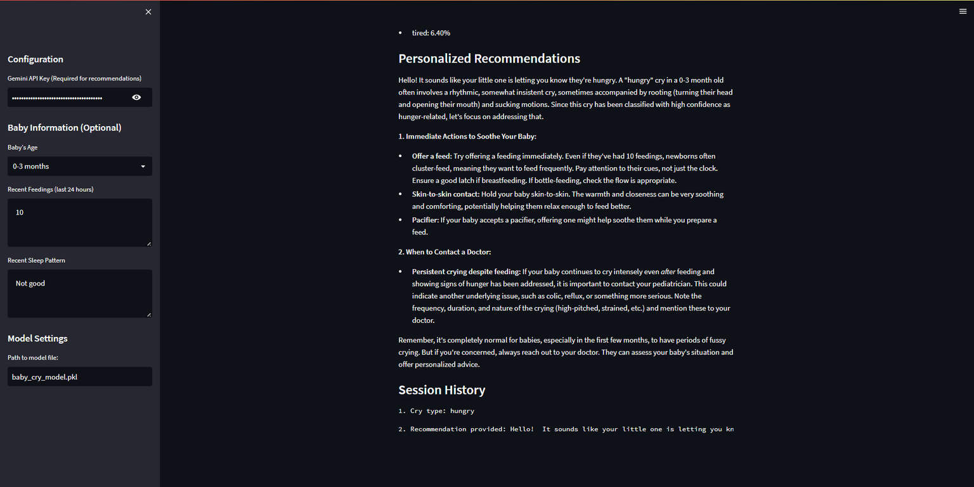
AGENTIC SYSTEM

Slide 27
REFERENCES
  https://pmc.ncbi.nlm.nih.gov/articles/PMC5323467/
  https://www.clinicbarcelona.org/en/news/a-study-identifies-the-cause-of-infant-crying-in-order-to-improve-the-infant-parent-relationship
  https://pmc.ncbi.nlm.nih.gov/articles/PMC10100257/

Slide 28
REFERENCES
[1] Pal, P., Iyer, A.N. and Yantorno, R.E., 2006, May. Emotion detection from infant facial expressions and cries. In 2006 IEEE International Conference on Acoustics Speech and Signal Processing Proceedings (Vol. 2, pp. II-II). IEEE.
[2] Yamamoto, S., Yoshitomi, Y., Tabuse, M., Kushida, K. and Asada, T., 2013. Recognition of a baby’s emotional cry towards robotics baby caregiver. International Journal of Advanced Robotic Systems, 10(2), p.86.
[3] Honda, K., Kitahara, K., Matsunaga, S., Yamashita, M. and Shinohara, K., 2012, December. Emotion classification of infant cries with consideration for local and global features. In Proceedings of The 2012 Asia Pacific Signal and Information Processing Association Annual Summit and Conference (pp. 1-4). IEEE.
[4] Noroozi, F., Akrami, N. and Anbarjafari, G., 2017, May. Speech-based emotion recognition and next reaction prediction. In 2017 25th Signal Processing and Communications Applications Conference (SIU) (pp. 1-4). IEEE.
[5] Tarunika, K., Pradeeba, R.B. and Aruna, P., 2018, July. Applying machine learning techniques for speech emotion recognition. In 2018 9th International Conference on Computing, Communication and Networking Technologies (ICCCNT) (pp. 1-5). IEEE.
[6] Cai, L., Jiang, C., Wang, Z., Zhao, L. and Zou, C., 2003, December. A method combining the global and time series structure features for emotion recognition in speech. In International Conference on Neural Networks and Signal Processing, 2003. Proceedings of the 2003 (Vol. 2, pp. 904- 907). IEEE.

Slide 29
REFERENCES
[7] Rajak, R. and Mall, R., 2019, October. Emotion recognition from audio, dimensional and discrete categorization using CNNs. In TENCON 2019-2019 IEEE Region 10 Conference (TENCON) (pp. 301-305). IEEE.
[8] Ashrafidoost, R., Setayeshi, S. and Sharifi, A., 2016, November. Recognizing Emotional State Changes Using Speech Processing. In 2016 European Modelling Symposium (EMS) (pp. 41-46). IEEE.
[9] Sharma, S. and Mittal, V.K., 2017, November. Infant cry analysis of cry signal segments towards identifying the crycause factors. In TENCON 2017-2017 IEEE Region 10 Conference (pp. 3105-3110). IEEE.
[10] Mittal, V.K., 2016, October. Discriminating features of infant cry acoustic signal for automated detection of cause of crying. In 2016 10th International Symposium on Chinese Spoken Language Processing (ISCSLP) (pp. 1-5). IEEE.
[11] Chang, C.Y., Hsiao, Y.C. and Chen, S.T., 2015, September. Application of incremental SVM learning for infant cries recognition. In 2015 18th International Conference on Network-Based Information Systems (pp. 607-610). IEEE.
[12] Osmani, A., Hamidi, M. and Chibani, A., 2017, November. Machine learning approach for infant cry interpretation. In 2017 IEEE 29th International Conference on Tools with Artificial Intelligence (ICTAI) (pp. 182-186). IEEE.

Slide 30
THANK YOU

